Slide 1
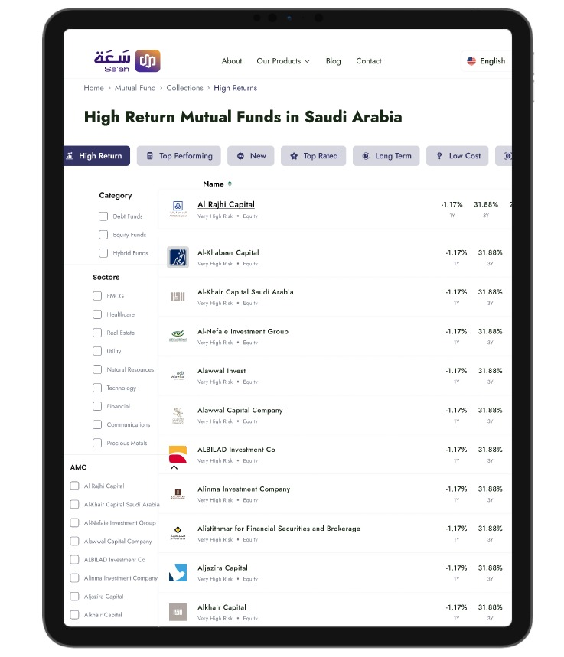
Saudi Investments, guiding your financial future.
Delivering trusted financial market Knowledge

Slide 2
Saudi Financial Market At your Fingertips.
- Stock Market
- Mutual Funds Marketplace
- Index
- Analysis

Slide 3
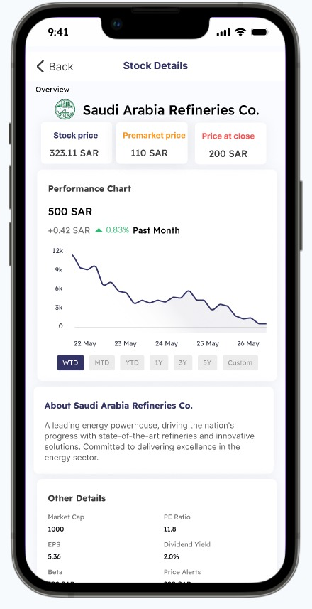
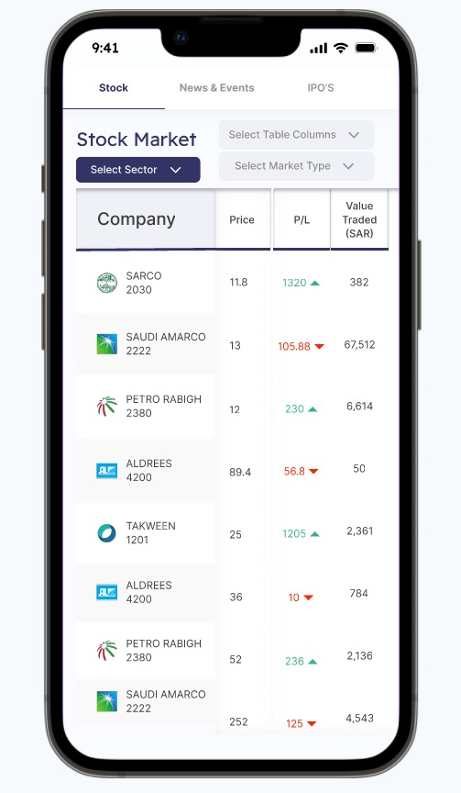
Stock Market
Easy for beginners, powerful for experts.
Execute market orders effortlessly.
Keep up with IPOs and bid on time.
Make smart decisions with expert tools.

Slide 4
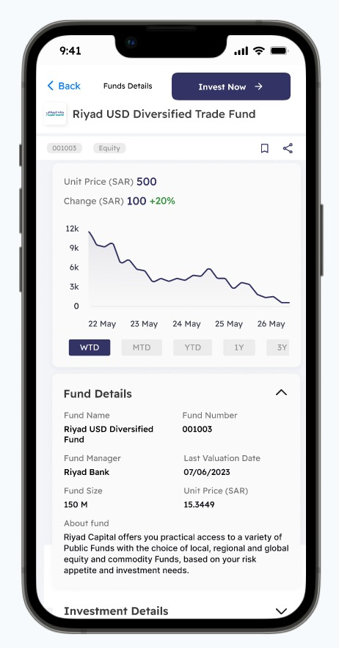
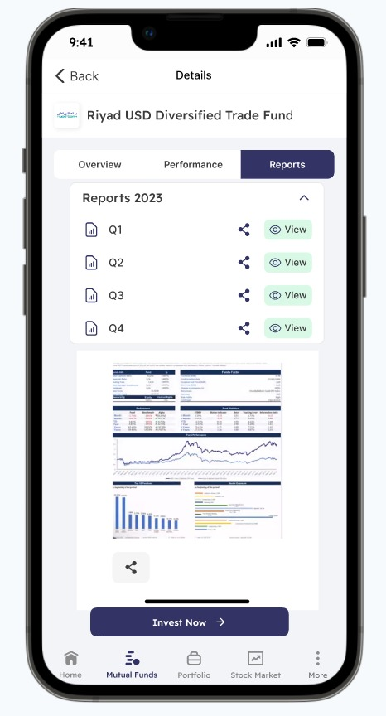
Mutual Funds Marketplace
Monitor past and present mutual fund performance.
Compare mutual funds head-to-head for informed choices.
Access comprehensive fund details easily.
Streamline account opening and management with one-time, paperless KYC processes for added convenience.
Subscribe directly to your chosen mutual fund.

Slide 5
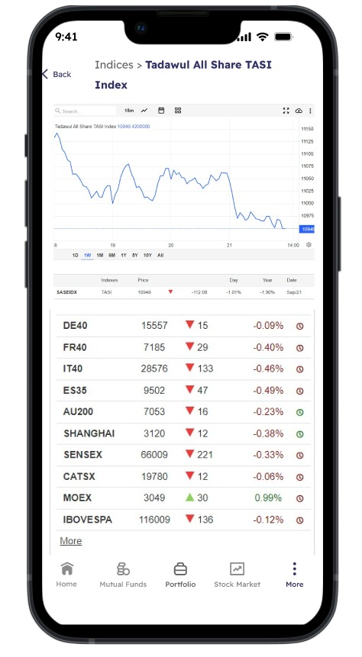
Index
We are creating Saudi indices because we believe they will play a crucial role in leading the global economies and serve as reliable indicators of overall economic performance. Similar to indices like the DAX or NASDAQ, Saudi indices are expected to exhibit significant volatility, offering multiple profit opportunities.

Slide 6
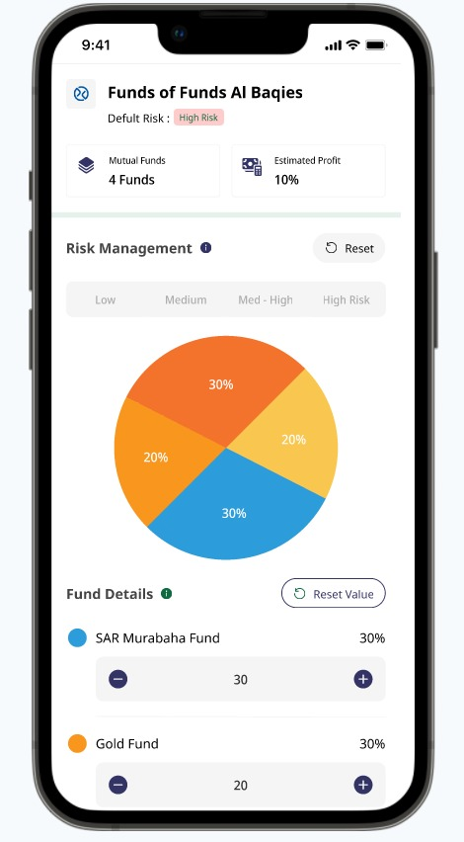
Financial Analytics Tools
Offers insights for trading decisions.
Identifies chart patterns for predictions.
Helps to understand the entry and exit points.
Aids in risk management levels.

Slide 7
Key Factors | Saah Capital's Role
Growing market with strong potential | Saah Capital recognizes the potential for further growth in the Saudi market and provides local investors and traders with sophisticated financial tools to capitalize on these opportunities.
Expanding mutual fund market | Saah Capital offers a range of mutual fund products tailored to the Saudi market, providing investors with diversified and professionally managed portfolios.
Flourishing market indices | Saah Capital develops index-based strategies that align with the performance of thriving Saudi market indices, ensuring clients can optimize their investments based on market trends.
44% annual increase in MENA IPOs | Saah Capital actively participates in IPO investments, leveraging AI algorithms to identify lucrative opportunities and offering financial tools that enhance investor success.
Oversubscribed IPOs in Saudi Arabia | Saah Capital acts as a bridge between investors and oversubscribed IPOs, ensuring that clients can access these high-demand offerings efficiently.
VISION 2030 Attracted more foreign investment | involves implementing reforms, modernizing infrastructure, and increasing transparency to create a more attractive and competitive marketplace for investors.

